Slide 1

CINEBUZZ
CS1010 COMPUTER SKILLS
Programming with PYTHON
TEAM MEMBERS
SAGAR SAHNI-1031310543
AYUSH AGGARWAL-1031310523
RISHAV MEDHI-1031310540
Faculty In-Charge:-
Ms. R. Pradeepa Assistant Professor,
DEPARTMENT OF COMPUTER SCIENCE AND ENGINEERING
SRM UNIVERSITY
Kattankulathur – 603 203
Tamil Nadu
November, 2013
Department: Computer Science And Engineering
Course: B.Tech.(UG)
Semester: 4
Section: I
Batch: 2013-14

Slide 2
OBJECTIVE
“The objective of this project is to create a website which accepts queries from users and displays the appropriate movie-names or nearby theatres with movie shows as results thereby eliminating to find these details by visiting different websites or by using various search engines”

Slide 3

INTRODUCTION
This project called “CINEBUZZ” is a query handling system aimed particularly for movie lovers and for those who seek movie details. This project accepts queries from users and depending upon the form of query, it displays two types of results
Details of the movie as entered in the query
Details of the theatres showing the movie which was mentioned in the query
The entire query processing application is made using Python and data for displaying results is stored in databases of MySQL and MongoDB. The data is regularly updated for new content and for this we have web crawlers which are also made using Python. The crawlers extracts theatre details and movie timings from BookMyShow.com. The movie details are extracted from IMDb.
The front-end of the project i.e. the website is made using HTML and CSS. The queries are transferred to backend via Python programs that filters the query to extract the necessary details and sends it to the appropriate application. The results are displayed on the website using JavaScript and Ajax calls.

Slide 4
APPLICATION
To allow its users to get information and synopsis on any movie of their choice.
To allow its users to get their nearby theatre showing the released movies along with showtimes.
To create an interface that is user friendly and give appropriate results.

Slide 5

ASSUMPTIONS
We have assumed that the user willing to get details of a movie gives a keyword “movie”, “film” or “cinema” along with the movie name. Eg. Interstellar movie
We have assumed that the user willing to get details of theatres showing a particular movie and timings of each show gives a keyword “theatre” along with the movie name and the place the user wants. Eg. Theatres showing Furious 7 in Lucknow

Slide 6
SNAPSHOTS

Slide 7
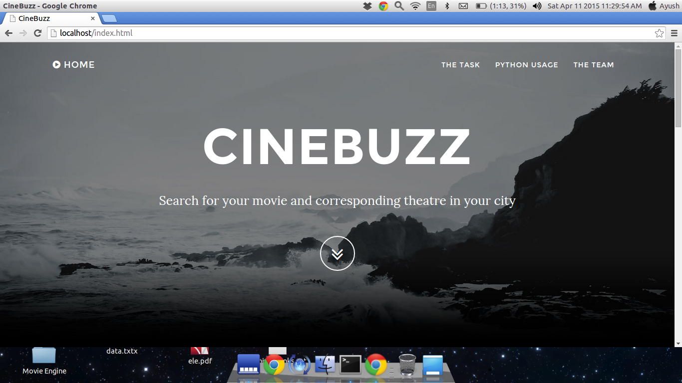

Slide 8
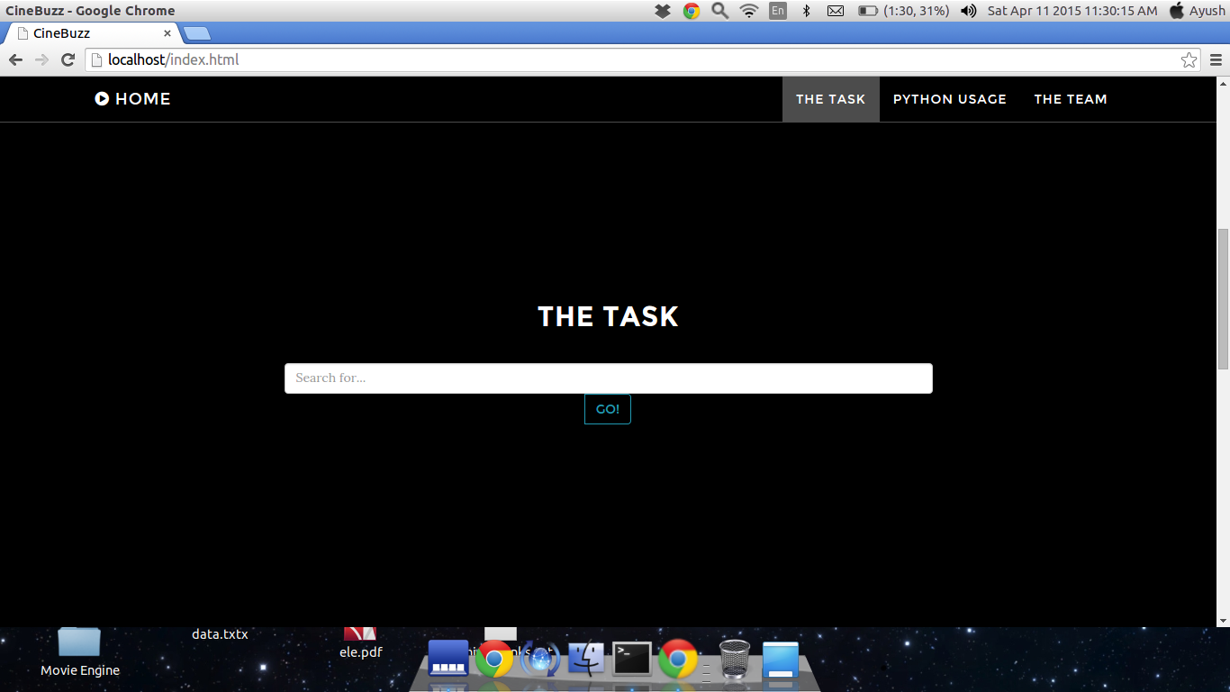

Slide 9
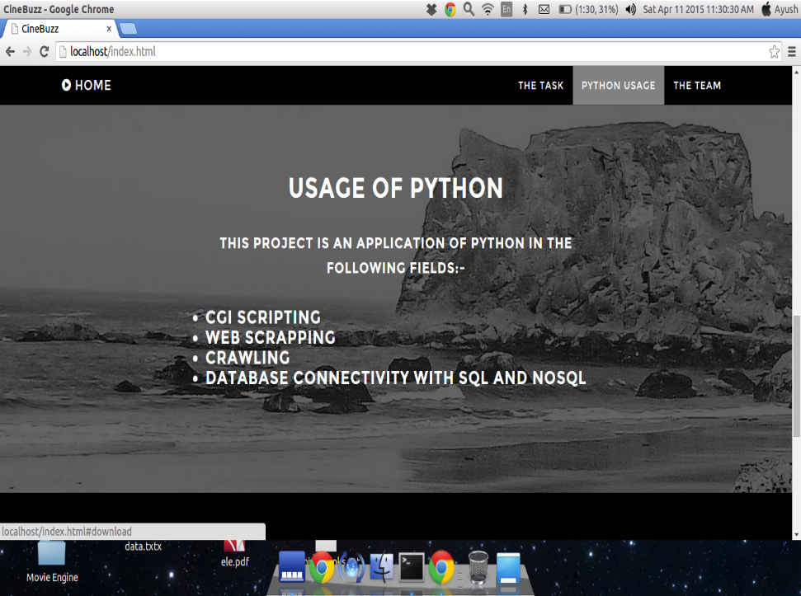

Slide 10
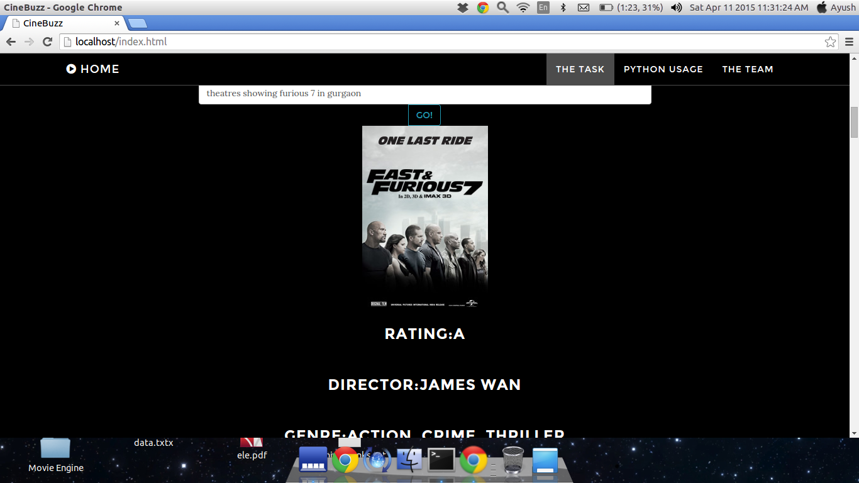

Slide 11
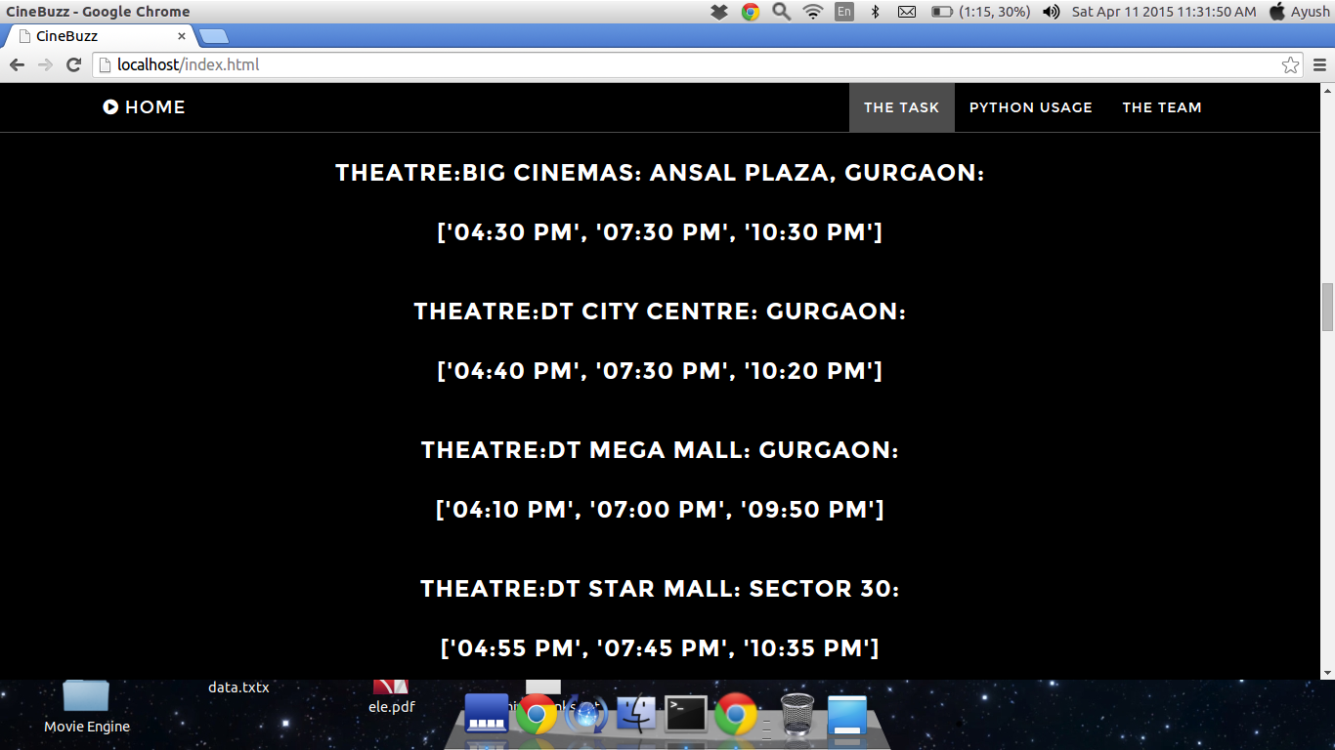

Slide 12
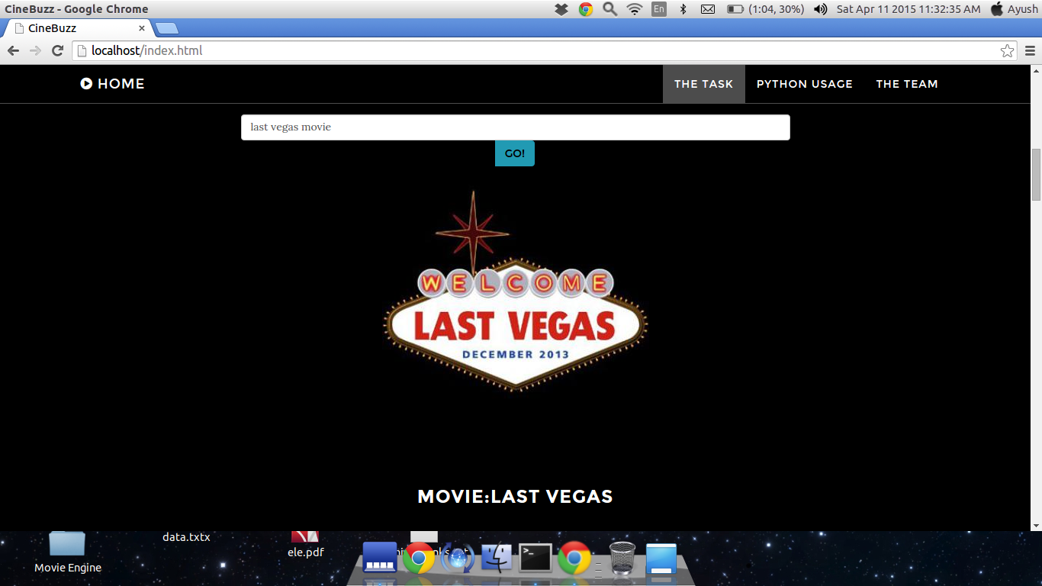

Slide 13
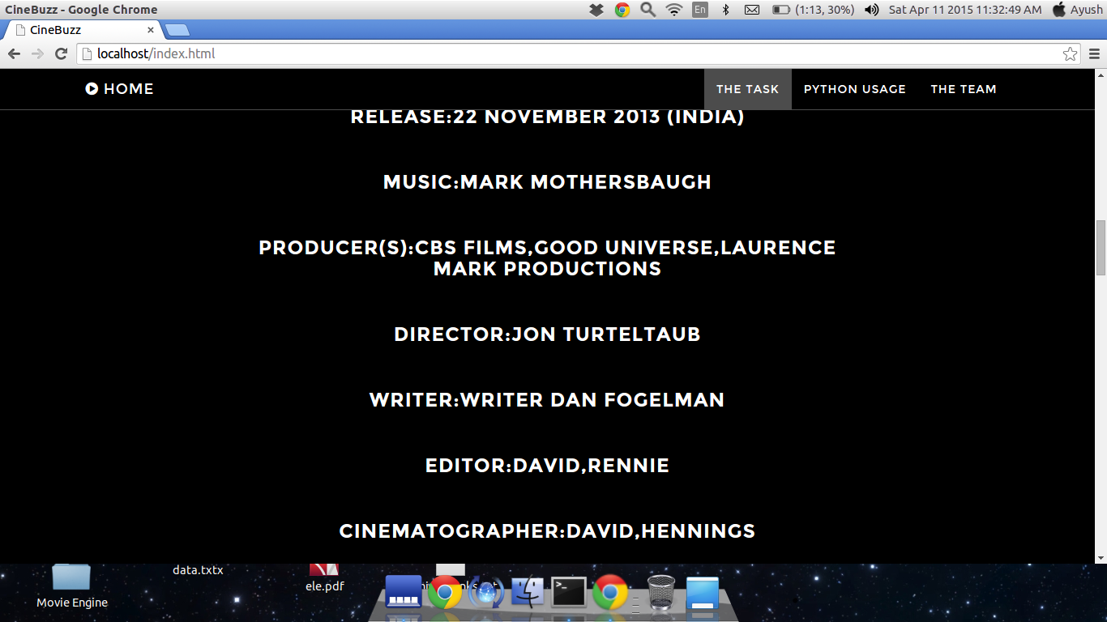

Slide 14
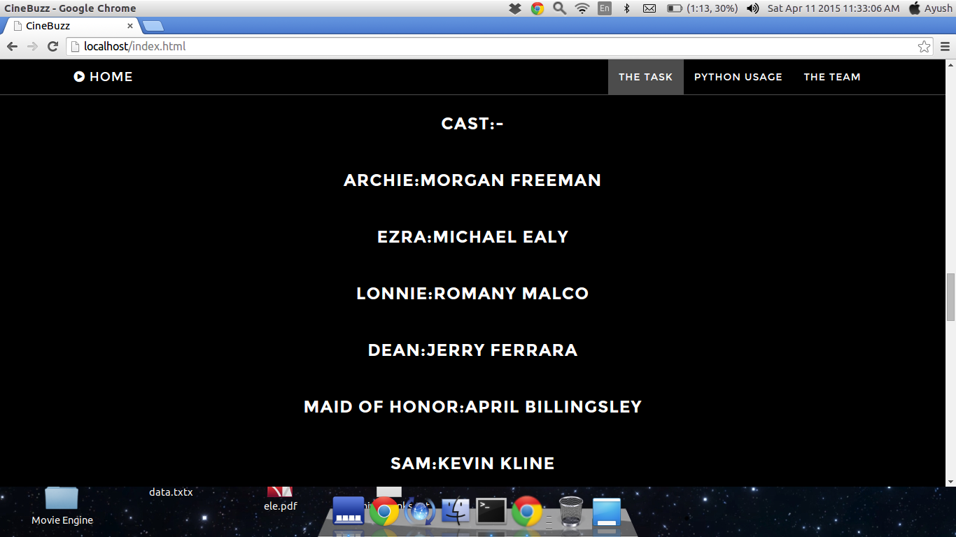

Slide 15
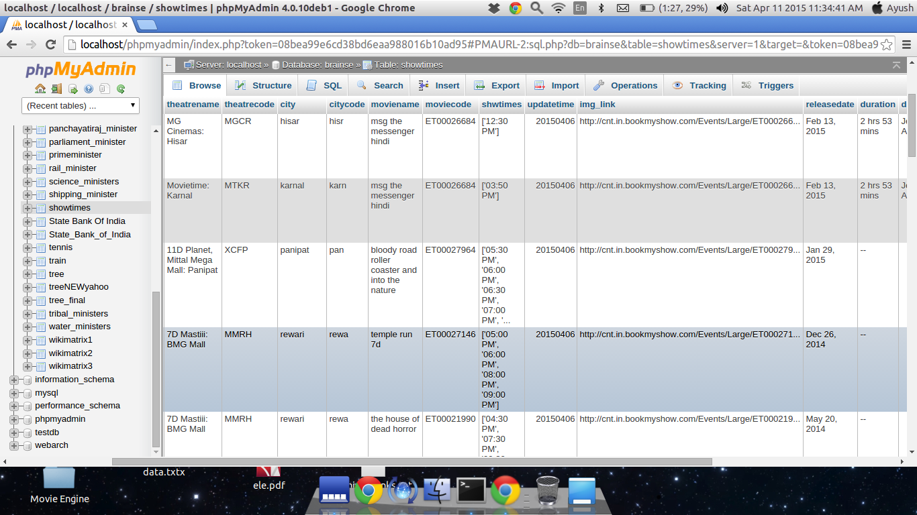

Slide 16
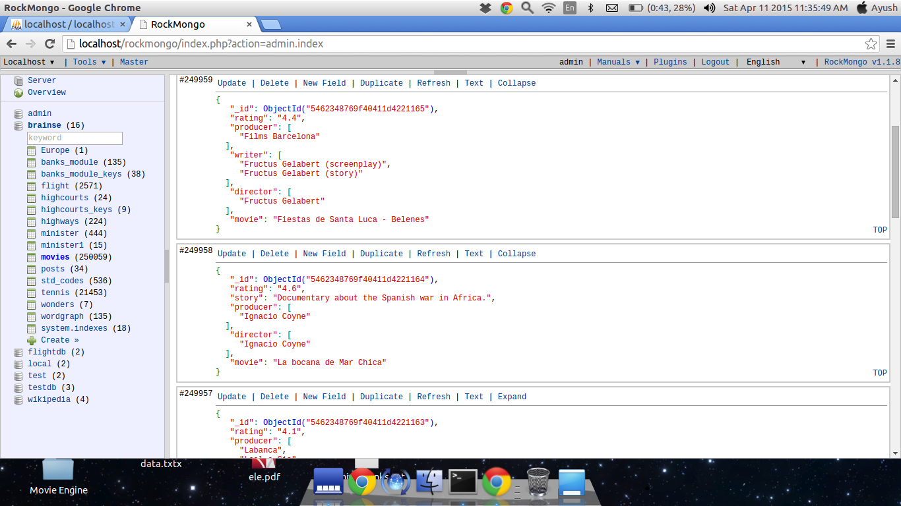

Slide 17
FUTURE ENHANCEMENTS
To install it on a proper server so as to establish it as a client server project and allow its users to directly use it as a website.
To take into consideration a much wider range of keywords that can even remotely relate to the module’s functionality and incorporating them into the project.
To do a more complex query handling so as to reduce the minimal chances of failure.
To use the project on a better hardware platform than using our machine as a local server.

Slide 18
CONCLUSION
CINEBUZZ was completed successfully. Using this project, one can directly search for movie show times in theatres and also search for movie details without going to different websites.

Slide 19
roles
Sagar Sahni : development of front-end and query filtering to transfer appropriate details to backend using Python
Ayush Aggarwal: development of back-end regarding query processing and retrieval for displaying movie details. Also created the movie crawler.
Rishav Medhi: development of back-end regarding query processing and retrieval for displaying theatre details. Also created the theatre crawler.

Slide 20
REFERENCES
Beginning Python from Novice to Professional – Magnus Lie Hetland
Programming with Python – Oh Really Publishers
docs.mongodb.org
python.org
tutorialspoint.com
w3schools.com
stackoverflow.com

Slide 21
THANK YOU

